Slide 1
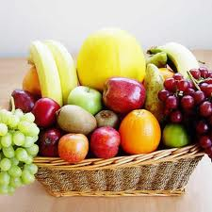
Fruit Forms

Slide 2
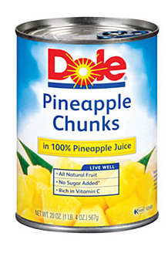
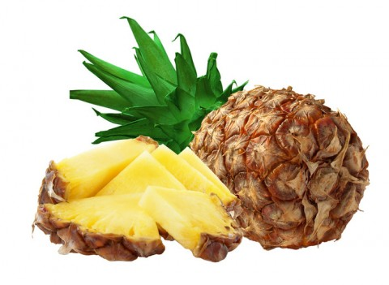
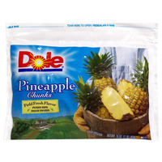
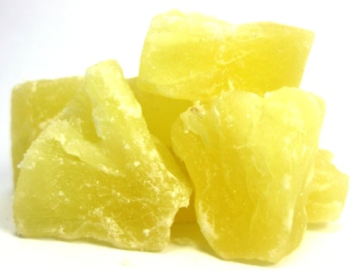
Fruit Forms
Fruit can be bought in four main forms
Fresh
Frozen
Canned
Dried

Slide 3
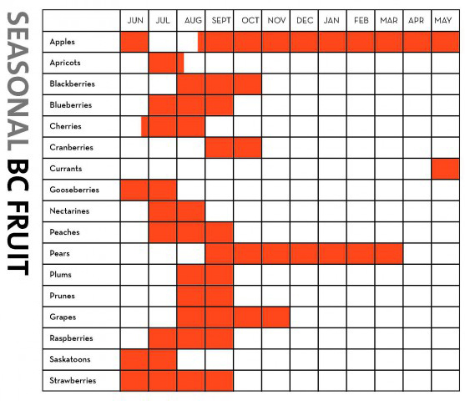
Fresh Fruit
Taste and quality of fruit are best during peak growing season
Price is lowest during fruit’s growing season
Most nutritious
Wash before eating

Slide 4
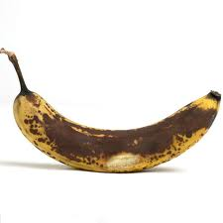
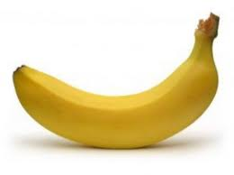
When Buying Fresh
Look for the following characteristics:
Feels heavy and firm
Has no cuts, bruises or decay
Smells pleasant
Isn’t sticky, wrinkled or moldy
Yes No

Slide 5
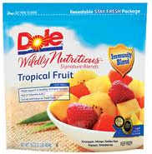
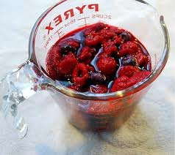
Frozen Fruit
Most like fresh in color and taste
Good choice when fresh isn’t available
Generally retain their nutrients
Available sweetened and unsweetened
Less expensive than fresh (out of season)
Fruit is sold whole or in pieces
Looses texture/shape when thawed

Slide 6
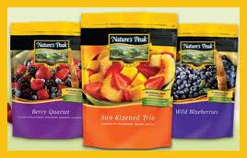
When Buying Frozen
Look for packages that are clean and solidly frozen in pieces
Read labels for added sugar and fruit form (whole, sliced, etc.)

Slide 7
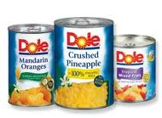
Canned Fruit
They can be whole, sliced, or in pieces
Packed in juice, light or heavy syrup
Usually less expensive
Least nutritious
Can be stored up to a year

Slide 8
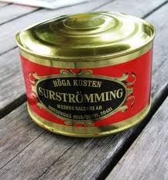
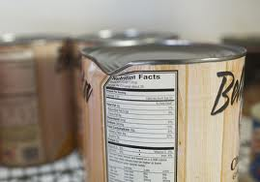
When Buying Canned
Avoid cans with dents, bulges or leaks
Read labels to determine fruit variety needed
  Whole, sliced, halves
Try to pick fruits in natural fruit juices or light syrup

Slide 9
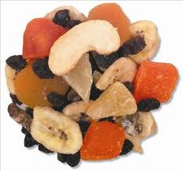
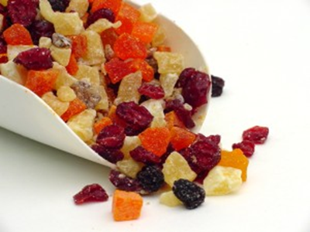
Dried Fruit
Have had most of their water removed
Concentrated source of nutrients
Convenient, transportable and easy to store
Maintain their quality for many months

Slide 10
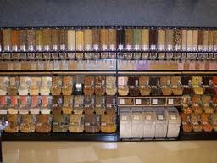
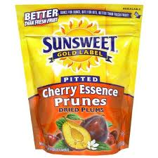
When Buying Dried Fruit
Look for bags or boxes that are unopened
Can buy loose by the pound in bulk section
Should look soft and pliable

Slide 11
 | APPEARANCE | TEXTURE | TASTE | PRICE | Unit Price
FRESH
FROZEN
CANNED
DRIED

